Slide 1
Financial Assets Valuation
Concept of financial assets;
Key characteristics of bonds, common stocks and preferred
stocks;
Basic financial asset valuation models;
Valuation of bonds: perpetual bonds, zero coupon bonds, coupon bonds with a finite maturity, bond valuation with semiannual interest;
Discount bond and premium bond;
Bond yields: Current yield, Capital gain yield, holding period return, yield to maturity, yield to call;
Dividend discount model for stock valuation: zero-growth model, normal growth model, super-normal growth model, single period valuation, multi-period valuation;
Valuation of preferred stock

Slide 2
Concept of Financial Assets
Assets are the things that is owned which has economic value and also posses potential for generating more value.
Assets are of two types:
Tangible (Real Assets)
Intangible (Financial Assets)
Financial Assets does not posses the productive capacity. They are used to finance the physical or real assets which are productive.
Examples: Government Bonds, Corporate Bonds, Treasury Bill, Common stock, Preferred Stock, Municipal Bond
Characteristics of financial Assets:
No physical existence
More liquid
Do not have own productive capacity
Easy mobility
Assets and Liability (Two parties, assets for one and liability for other)

Slide 3
Meaning and Characteristic of Bonds
A long term debt instrument issued by a corporation or government
Bond is long term contract under which a borrower agrees to make payments of interest and principal on specific dates, to the holders of the bond.
Specified time may be quarterly or semiannually or annually. In Nepal normally interest is paid semiannually.
Key Characteristics:
Par Value (Face value / Maturity Value / Principal Value)
In Nepal the face value of bond or debenture must be Rs 1,000
Maturity Date
Most bonds have original maturities ranging from 10 to 40 years
Coupon Interest rate
Amount of interest specified in coupon is coupon payment and rate is called coupon interest rate
Call Provision
Gives the issuing corporate right to redeem the bonds prior to maturity under specified terms at higher price than par value which is called call premium

Slide 4
Characteristic of Bonds
Continued…
Sinking fund or Bond Redemption Fund
Facilitates the orderly retirement of the bond
Bonds that have sinking funds are regarded as being safer than those without such provision.
Indenture
Legal agreement for contract that contains terms and condition of a bond issue
Trustee
Third party to bond indenture
Act as a watchdog on behalf of the bond holders
Conversion Feature
Convertibility into equity shares
Claims on Assets and Income
Claims of debt in general including bonds, are honored before those of both preferred stock and common stock

Slide 5
Basic Financial Assets Valuation Model
The valuation method states that the intrinsic value of an asset is equal to the sum of the present value of the asset’s cash flow.
Value of Bond (V₀) = PV of coupon payment + PV of maturity value
Where, V₀ = Current value of assets
CF_{n} = Expected future cash flows in period (t)
k = Investor’s required rate of return(Cost of capital)
n = Expected life of assets
Example Problem: Assume that the cash flow of an investment are Rs 2,000 and Rs 4,000 in year 1 and 2 respectively and discount rate is 20 percent. Using the capitalization of cash flow method, calculate the value of financial assets.

Slide 6
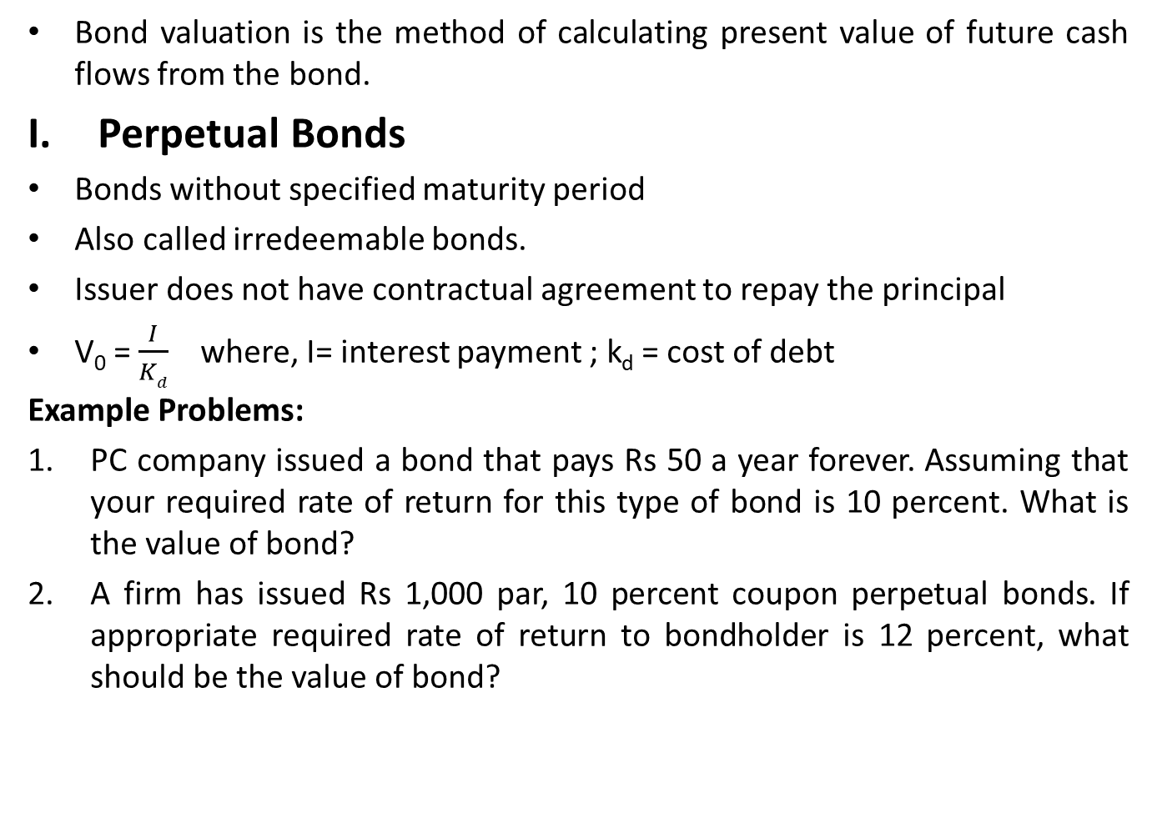
Valuation of Bonds
Bond valuation is the method of calculating present value of future cash flows from the bond.
Perpetual Bonds
Bonds without specified maturity period
Also called irredeemable bonds.
Issuer does not have contractual agreement to repay the principal
V₀ = $\frac{I}{Kd}$ where, I= interest payment ; k_{d} = cost of debt
Example Problems:
PC company issued a bond that pays Rs 50 a year forever. Assuming that your required rate of return for this type of bond is 10 percent. What is the value of bond?
A firm has issued Rs 1,000 par, 10 percent coupon perpetual bonds. If appropriate required rate of return to bondholder is 12 percent, what should be the value of bond?

Slide 7
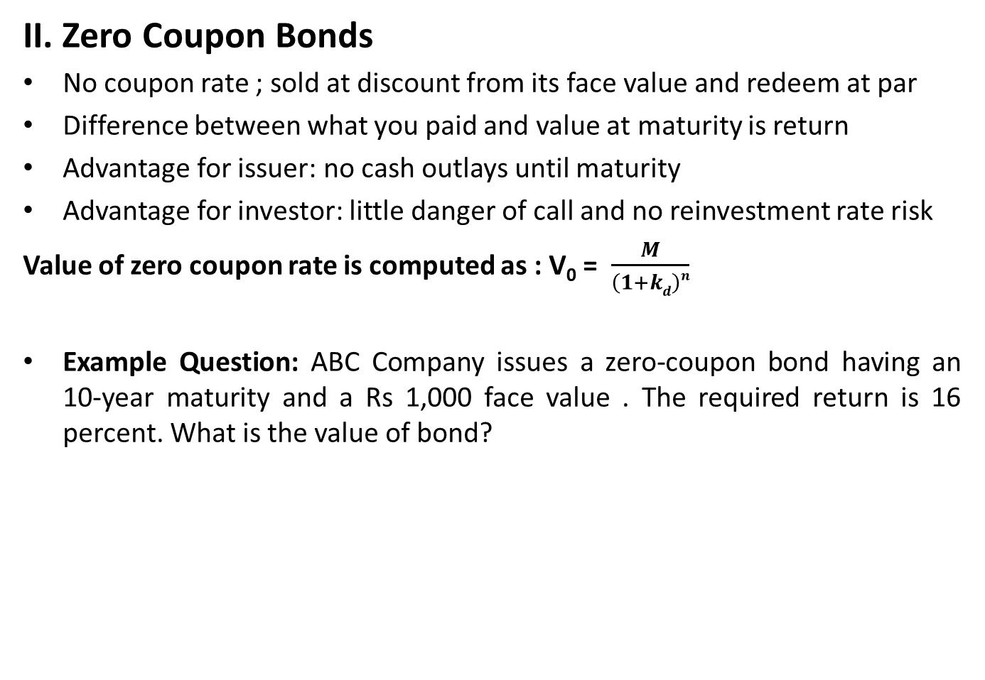
Valuation of Bonds
II. Zero Coupon Bonds
No coupon rate ; sold at discount from its face value and redeem at par
Difference between what you paid and value at maturity is return
Advantage for issuer: no cash outlays until maturity
Advantage for investor: little danger of call and no reinvestment rate risk
Value of zero coupon rate is computed as : V₀ = $\frac{M}{\left(1+kd\right)n}$
Example Question: ABC Company issues a zero-coupon bond having an 10-year maturity and a Rs 1,000 face value . The required return is 16 percent. What is the value of bond?

Slide 8
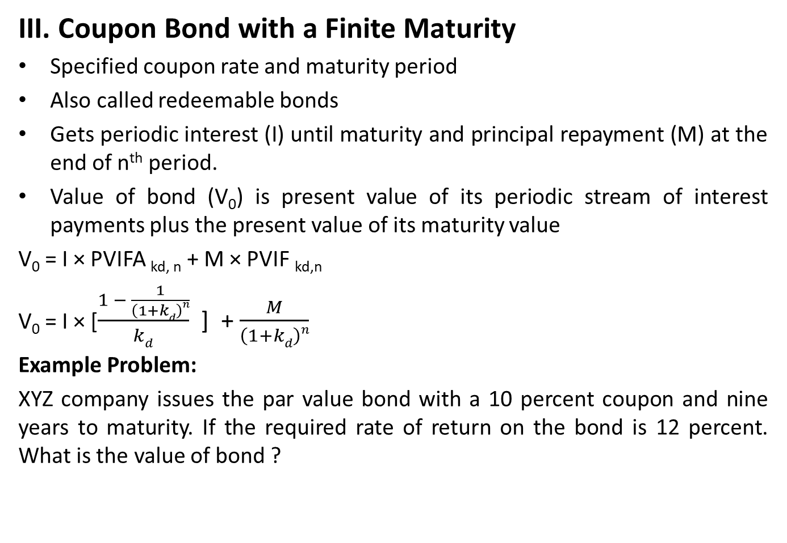
Valuation of Bonds
III. Coupon Bond with a Finite Maturity
Specified coupon rate and maturity period
Also called redeemable bonds
Gets periodic interest (I) until maturity and principal repayment (M) at the end of n^{th} period.
Value of bond (V₀) is present value of its periodic stream of interest payments plus the present value of its maturity value
V₀ = I × PVIFA _{kd, n} + M × PVIF _{kd,n}
V₀ = I × [$\frac{1 − \frac{1}{\left(1+kd\right)n}}{kd}$ ] + $\frac{M}{\left(1+kd\right)n}$
Example Problem:
XYZ company issues the par value bond with a 10 percent coupon and nine years to maturity. If the required rate of return on the bond is 12 percent. What is the value of bond ?

Slide 9
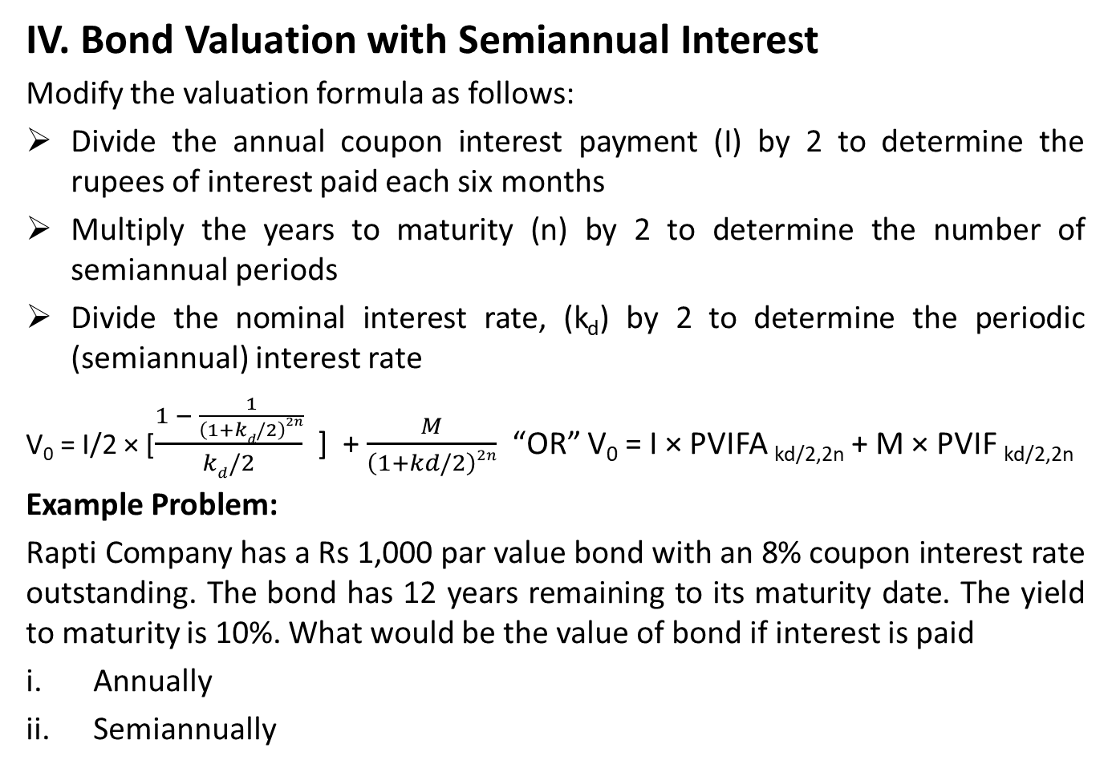
Valuation of Bonds
IV. Bond Valuation with Semiannual Interest
Modify the valuation formula as follows:
Divide the annual coupon interest payment (I) by 2 to determine the rupees of interest paid each six months
Multiply the years to maturity (n) by 2 to determine the number of semiannual periods
Divide the nominal interest rate, (k_{d}) by 2 to determine the periodic (semiannual) interest rate
V₀ = I/2 × [$\frac{1 − \frac{1}{\left(1+kd/2\right)2n}}{kd/2}$ ] + $\frac{M}{\left(1+kd/2\right)2n}$ “OR” V₀ = I × PVIFA _{kd/2,2n} + M × PVIF _{kd/2,2n}
Example Problem:
Rapti Company has a Rs 1,000 par value bond with an 8% coupon interest rate outstanding. The bond has 12 years remaining to its maturity date. The yield to maturity is 10%. What would be the value of bond if interest is paid
Annually
Semiannually

Slide 10
Discount Bond and Premium Bond
Discount Bond: Bond is selling at below par value
Premium Bond: Bond is selling at above par value
Example Problem:
A Brick Company has issued 10 percent, 10 year, Rs 1,000 par value bond. Calculate the value of bond at 12%, 10% and 8%
Investment Decision
Condition | Selling | Type of Bond
K_{d} = coupon rate | At Par | Par Bond
K_{d} > coupon rate | Below Par | Discount Bond
K_{d} < coupon rate | Above Par | Premium Bond
If | Then | Reason
V₀ > P₀ | Buy the Bond | The bond is undervalued
V₀ < P₀ | Do not buy the bond | The bond is overvalued
V₀ = P₀ | Be indifferent | The bond is correctly valued

Slide 11
Interest Rate Risk and Reinvestment Risk
Interest rate risk:
The risk in bond prices due to fluctuations in interest rate.
Investor may have to lose the higher yielding investment opportunity.
Depends on how sensitive its price is to interest rate change, which depends on two things:
Time to maturity
Coupon rate
Reinvestment Rate Risk
The risk that a decline in interest rates will lead to a decline in income.
Interest rate risk relates to the value of the bond in a portfolio, while reinvestment rate risk relates to the income portfolio produces
Shorter the amount of time until a bond’s maturity, less responsive is its market value to a given change in the required return.

Slide 12
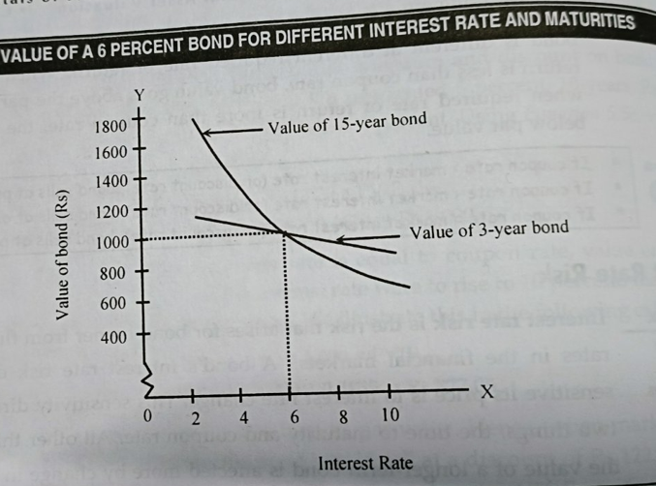
Interest Rate Risk and Reinvestment Risk

Slide 13
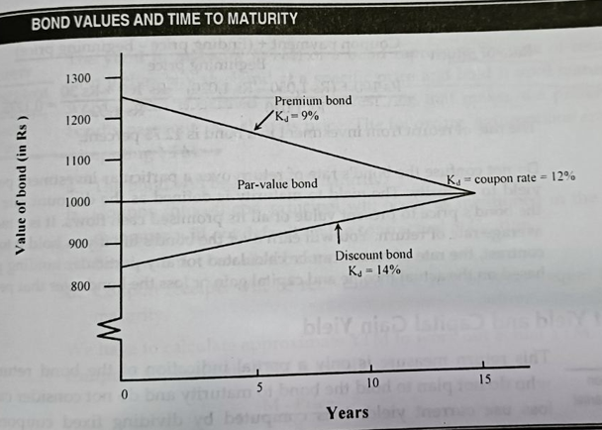
Changes in Bond Values Overtime
When the required return is different from the coupon interest rate and remains constant until maturity, the value of bond will approach its par value with the passage of time
Required rate of return | Remaining time to maturity (years)
 | 15 | 10 | 5
9% | Rs 1,242.30 | Rs 1192.20 | Rs. 1116.80
12% | Rs 1,000.00 | Rs 1000.00 | Rs. 1000.00
14% | Rs 877.00 | Rs 895.90 | Rs. 931.00

Slide 14
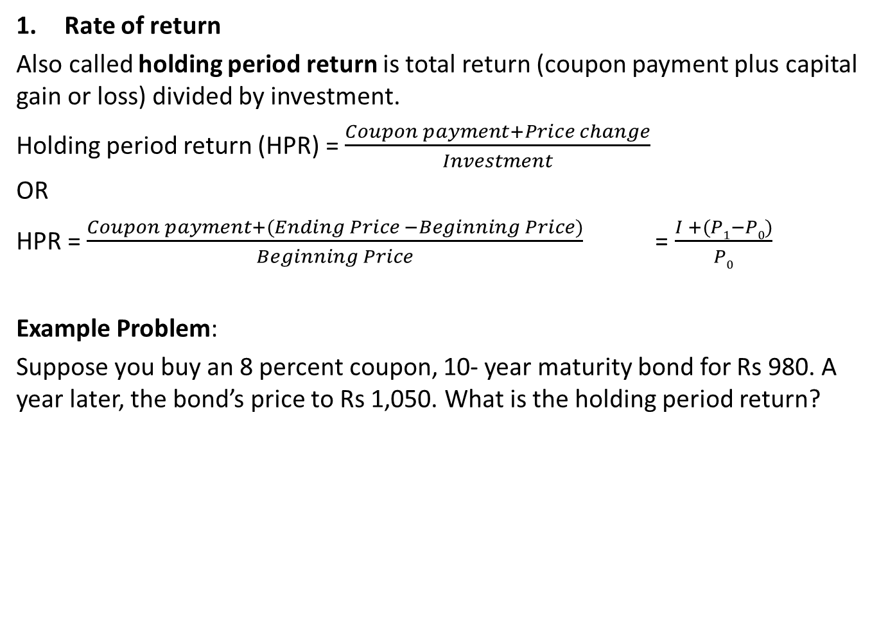
Bond Yields
Rate of return
Also called holding period return is total return (coupon payment plus capital gain or loss) divided by investment.
Holding period return (HPR) = $\frac{Coupon payment+Price change}{Investment}$
OR
HPR = $\frac{Coupon payment+(Ending Price −Beginning Price)}{Beginning Price}$ = $\frac{I +(P1−P0)}{P0}$
Example Problem:
Suppose you buy an 8 percent coupon, 10- year maturity bond for Rs 980. A year later, the bond’s price to Rs 1,050. What is the holding period return?

Slide 15
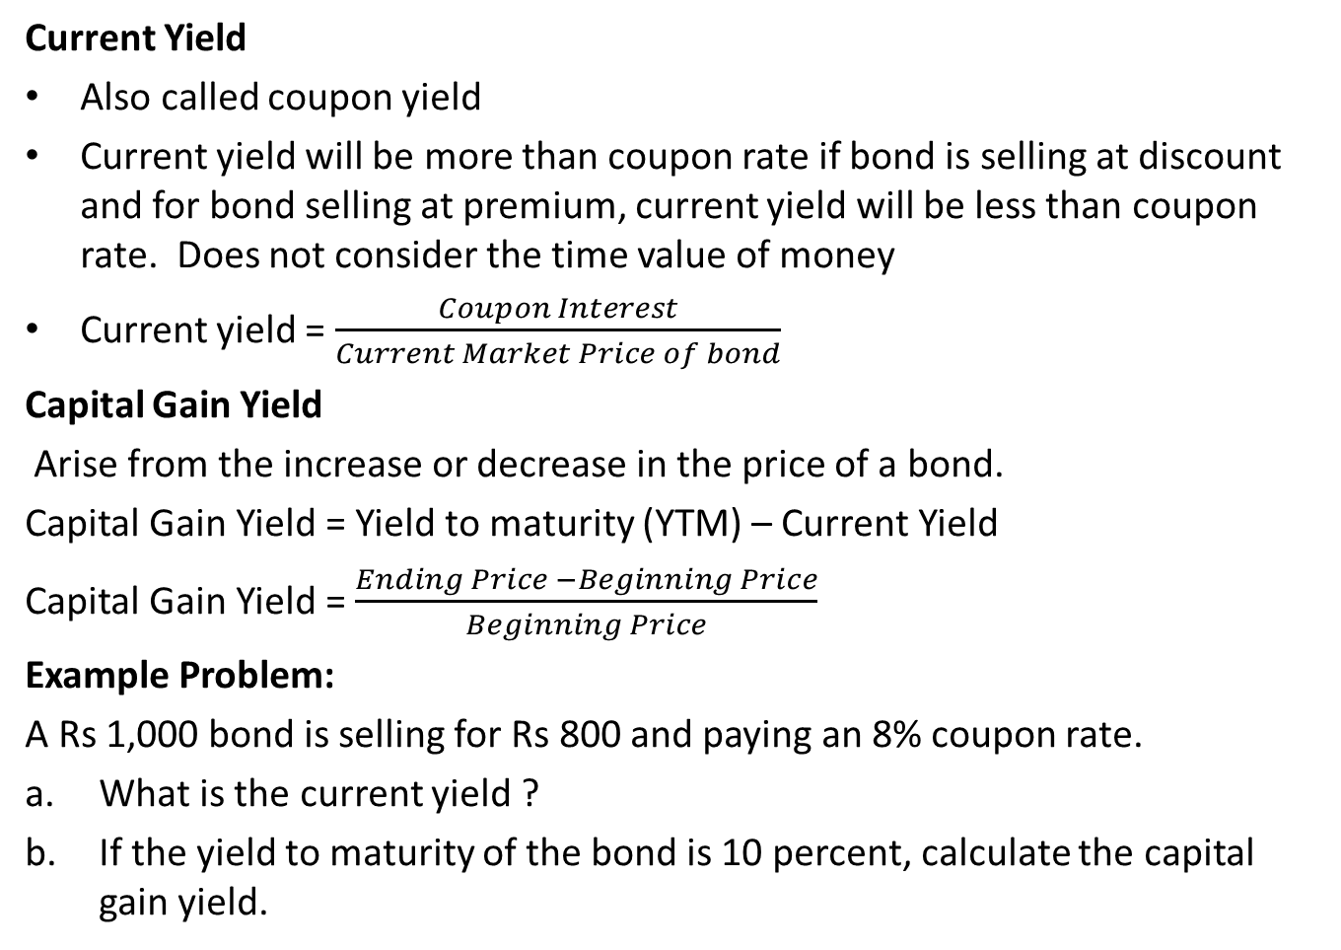
Current Yield and Capital Gain Yield
Current Yield
Also called coupon yield
Current yield will be more than coupon rate if bond is selling at discount and for bond selling at premium, current yield will be less than coupon rate. Does not consider the time value of money
Current yield = $\frac{Coupon Interest}{Current Market Price of bond}$
Capital Gain Yield
Arise from the increase or decrease in the price of a bond.
Capital Gain Yield = Yield to maturity (YTM) – Current Yield
Capital Gain Yield = $\frac{Ending Price −Beginning Price}{Beginning Price}$
Example Problem:
A Rs 1,000 bond is selling for Rs 800 and paying an 8% coupon rate.
What is the current yield ?
If the yield to maturity of the bond is 10 percent, calculate the capital gain yield.

Slide 16
Yield to Maturity (YTM)
Anticipated rate of return on bond if it is hold until the maturity date.
Rate that equals the present value of bond’s payment with current market price of the bond.
It considers all cash flows received over the life of an issue.
Other things being equal, higher the YTM, the more attractive it is to investors.
Computed under certain assumptions:
Bond will be held until maturity.
Coupons are immediately reinvested at YTM
Bond will not be called or redeemed by the issuer before maturity
All cash flows will occur as indicated in the indenture

Slide 17
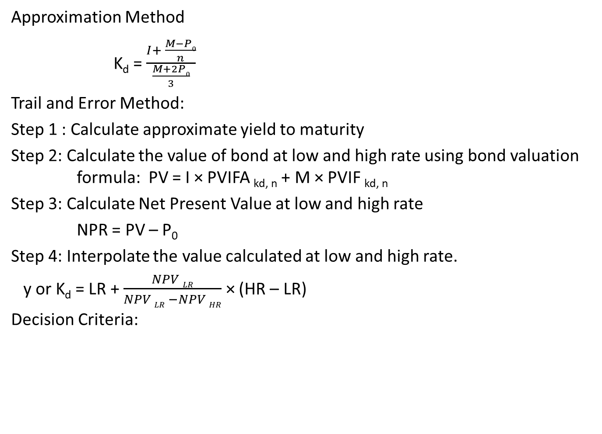
YTM for Coupon Bond
Approximation Method
K_{d} = $\frac{I+ \frac{M−P0}{n}}{\frac{M+2P0}{3}}$
Trail and Error Method:
Step 1 : Calculate approximate yield to maturity
Step 2: Calculate the value of bond at low and high rate using bond valuation formula: PV = I × PVIFA _{kd, n} + M × PVIF _{kd, n}
Step 3: Calculate Net Present Value at low and high rate
NPR = PV – P₀
Step 4: Interpolate the value calculated at low and high rate.
y or K_{d} = LR + $\frac{NPV LR}{NPV LR −NPV HR}$ × (HR – LR)
Decision Criteria:
If | Then | Reason
YTM > minimum required rate of return | Buy the Bond | Undervalued
YTM < minimum required rate of return | Do not buy the Bond | Overvalued
YTM = minimum required rate of return | Be indifferent | Correctly Valued

Slide 18
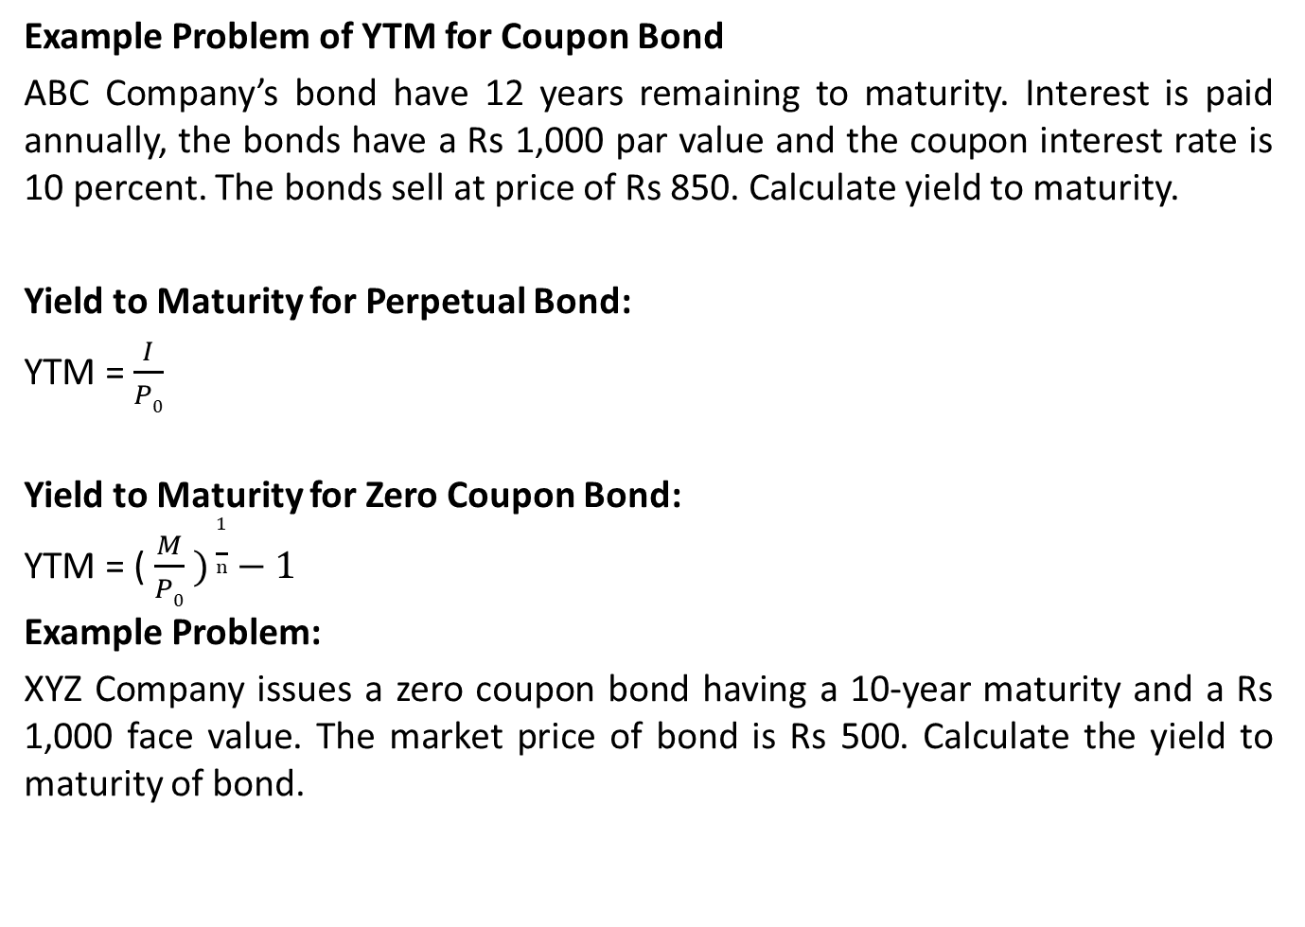
YTM
Example Problem of YTM for Coupon Bond
ABC Company’s bond have 12 years remaining to maturity. Interest is paid annually, the bonds have a Rs 1,000 par value and the coupon interest rate is 10 percent. The bonds sell at price of Rs 850. Calculate yield to maturity.
Yield to Maturity for Perpetual Bond:
YTM = $\frac{I}{P0}$
Yield to Maturity for Zero Coupon Bond:
YTM = ($\frac{M}{P0} )\frac{1}{n}−1$
Example Problem:
XYZ Company issues a zero coupon bond having a 10-year maturity and a Rs 1,000 face value. The market price of bond is Rs 500. Calculate the yield to maturity of bond.

Slide 19
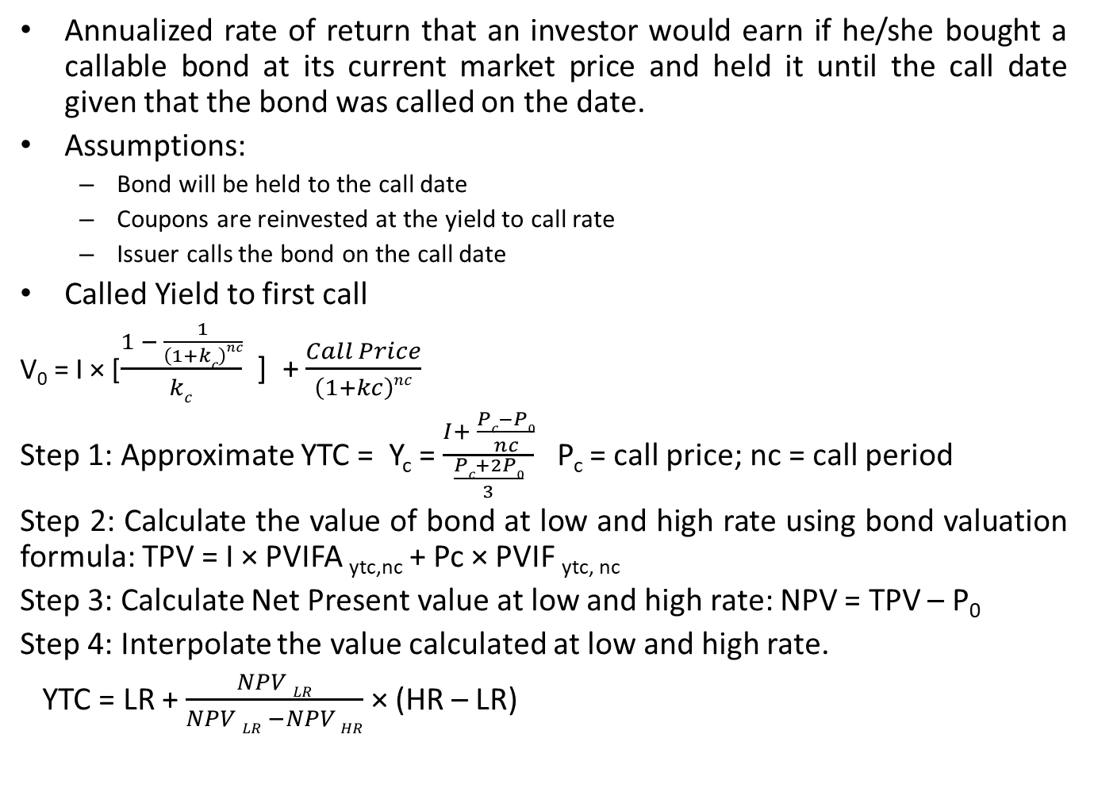
Yield To Call (YTC)
Annualized rate of return that an investor would earn if he/she bought a callable bond at its current market price and held it until the call date given that the bond was called on the date.
Assumptions:
Bond will be held to the call date
Coupons are reinvested at the yield to call rate
Issuer calls the bond on the call date
Called Yield to first call
V₀ = I × [$\frac{1 − \frac{1}{\left(1+kc\right)nc}}{kc}$ ] + $\frac{Call Price}{\left(1+kc\right)nc}$
Step 1: Approximate YTC = Y_{c} = $\frac{I+ \frac{Pc−P0}{nc}}{\frac{Pc+2P0}{3}}$ P_{c} = call price; nc = call period
Step 2: Calculate the value of bond at low and high rate using bond valuation formula: TPV = I × PVIFA _{ytc,nc} + Pc × PVIF _{ytc, nc}
Step 3: Calculate Net Present value at low and high rate: NPV = TPV – P₀
Step 4: Interpolate the value calculated at low and high rate.
YTC = LR + $\frac{NPV LR}{NPV LR −NPV HR}$ × (HR – LR)

Slide 20
YTC
Example Problem
Ram Singh recently purchased a bond with a Rs 1,000 face value, a 10% coupon rate, and four years to maturity. The bond makes annual payments, the first to be received one year from now. Ram paid Rs 1,032.40 for the bond. If the bond can be called two years from now at a price of Rs 1,100, what is the yield to call?
Realized Rate of Return
The annualized rate of return on the bond that is realized if the interim coupons are reinvested at other rate than YTM

Slide 21
Common Stocks
Represent ownership position in a company and have residual claim on income and assets.
Entitled to receive dividends
Two basic functions:
Sources of financing and collateral for debt capital
Major source of financing Fixed assets

Slide 22
Features of Common Stocks
Par Value
Maturity
Claim on income
Claim on assets
Right to control
Voting rights
Proxy rights
Pre-emptive right
Limited liability

Slide 23
Valuation of common stock
Dividend discount model
a) Zero growth DDM
If growth in dividend is by zero percentage is called zero growth. This model assumed that dividend will be constant overtime. i.e.
D₀ = D₁ = D₂ = D_{n}
Value of stock can be calculate by following equation
P₀ =
Where, P₀ = Intrinsic (true) value of common stock
D = Dividend per share
k = require rate of return

Slide 24
Example 8
The dividend of ABC Company is estimated to be Rs. 8 per share indefinitely. What is current value of share if an investor requires a 10% rate of return on his investment?
P₀ =

Slide 25
b) Constant or Normal growth DDM
The constant growth model assumed that dividend will grow at constant rate. The stock with a constant dividend growth is actually a growing perpetuity.
Let g be a constant rate which dividend grows forever. Therefore, dividends are computed as:

Slide 26

Constant or Normal growth DDM
When we substitute them in Equation, the current price of the stock is obtained as
Assume that g is smaller than r_{e}. In this case the general formula becomes

Slide 27
Example 9
Fast Food Manufacturing Company’s dividend is expected to grow at the rate or 10% per annum. The last year dividend of Fast Food Manufacturing Company was Rs. 3 per share. What price will you pay for it if your required rate of return for this equity is 15%?
D₁ = D₀ (1+g) = 3 (1+0.10) = Rs. 3.3
=

Slide 28


C) Multiple growth model
The dividend of company may not grow at constant rate. Future growth rate might shift up or down. In this case, we need to extend the constant dividend growth model and define sub-periods with different growth rates. Then we can estimate the value of stock by considering each sub period with their discounting.
Find present value, PV(NCD), of non-constant growth dividends, D_{k}(NC) at each sub periods 1 ≤ t ≤ n as
Find present value of constant growth dividends PV(P_{t} ) where

Slide 29

C) Multiple growth model
Then the present value of the stock is basically sum of present values of all dividends as
If a stock has non-constant growth in dividend up to three years and constant rate of growth then after, Price of the sock can be determined as:

Slide 30
Example 10
The next three years dividends for Company Y are expected to be £0.50, £1.00, £1.50. Then the dividends are expected to grow at a constant 5% forever. If the required return is 10%, then what is the value of the stock?
For the non-constant dividend growth

Slide 31
For the constant dividend growth based on third year dividend D₃
The current price of the stock is the present value of the stock

Slide 32
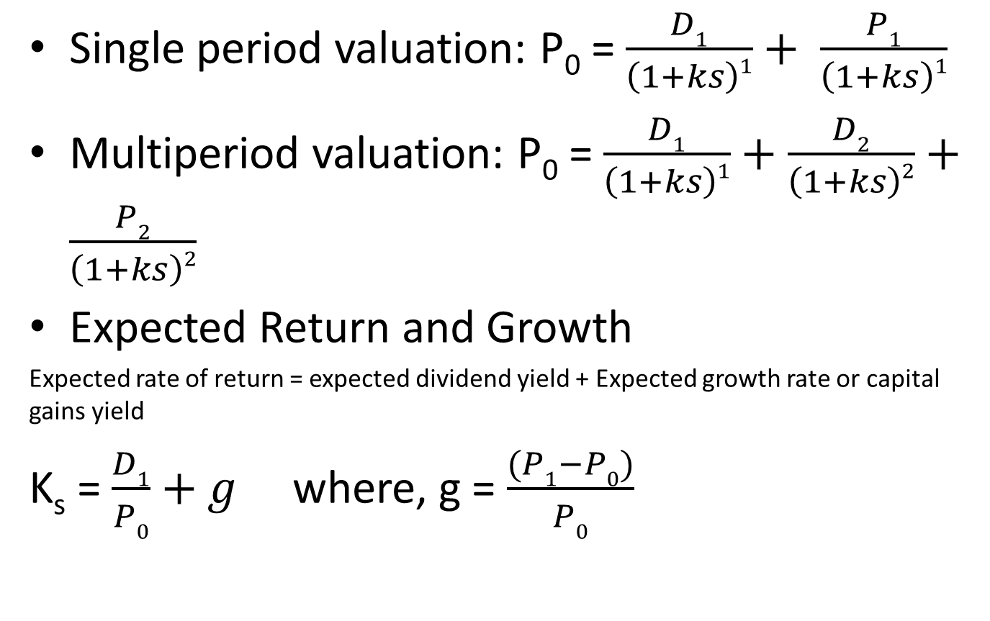
Single Period Valuation and Multiperiod Valuation
Single period valuation: P₀ = $\frac{D1}{\left(1+ks\right)1}+ \frac{P1}{\left(1+ks\right)1}$
Multiperiod valuation: P₀ = $\frac{D1}{\left(1+ks\right)1}+\frac{D2}{\left(1+ks\right)2}+\frac{P2}{\left(1+ks\right)2}$
Expected Return and Growth
Expected rate of return = expected dividend yield + Expected growth rate or capital gains yield
K_{s} = $\frac{D1}{P0}+g$ where, g = $\frac{(P1−P0)}{P0}$

Slide 33
Preferred Stock
Long term sources of financing
Fixed amount of dividend out of earning of company after payment of debenture interest and tax
Does not convey voting power
Preferred dividend are usually cumulative
Preferred dividend are not tax deductible expenses

Slide 34
Features of Preferred Stock
Fixed Dividend
Cumulative Dividends
Par Value
Participative Feature
Voting Rights
Claims on Income and Assets
Redemption / Retirement
Sinking Fund
Call Provision
Convertibility

Slide 35
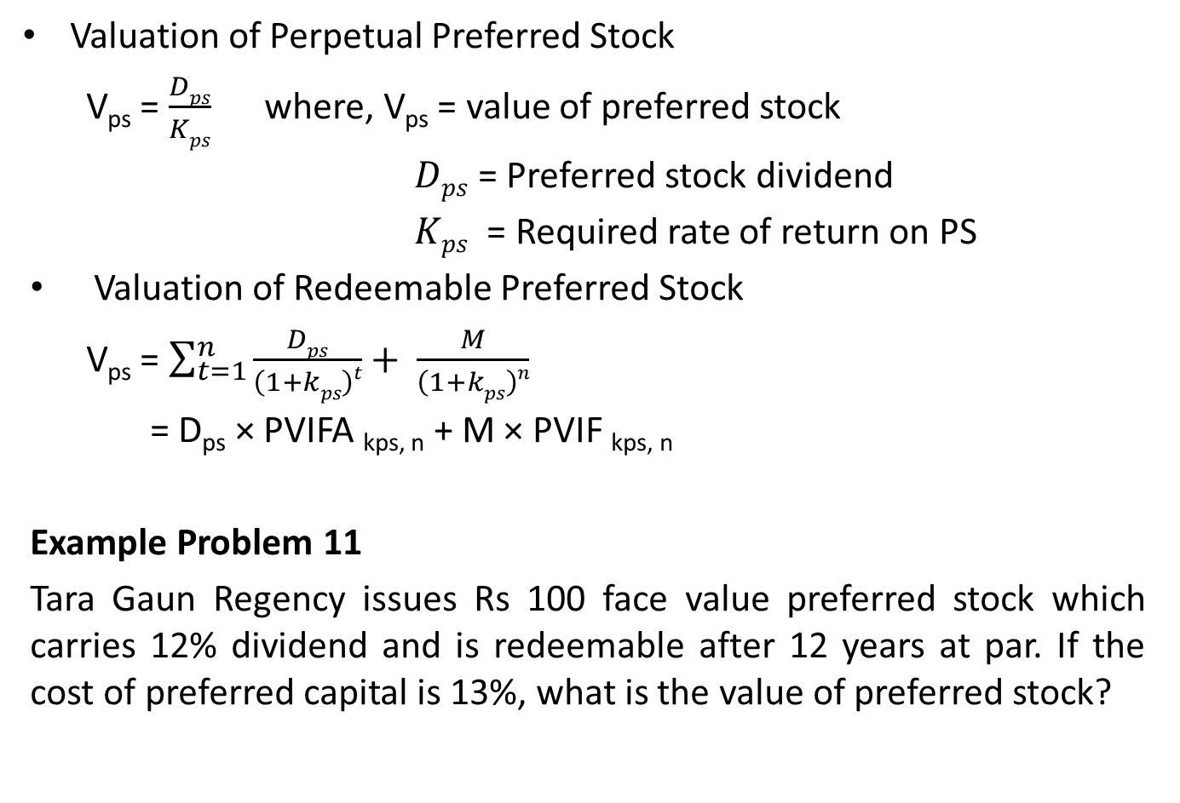
Preferred Sock Valuation
Valuation of Perpetual Preferred Stock
V_{ps} = $\frac{Dps}{Kps}$ where, V_{ps} = value of preferred stock
$Dps$ = Preferred stock dividend
$Kps$ = Required rate of return on PS
Valuation of Redeemable Preferred Stock
V_{ps} = $\sum_{t=1}^{n}{\frac{Dps}{\left(1+kps\right)t}}+ \frac{M}{\left(1+kps\right)n}$
= D_{ps} × PVIFA _{kps, n} + M × PVIF _{kps, n}
Example Problem 11
Tara Gaun Regency issues Rs 100 face value preferred stock which carries 12% dividend and is redeemable after 12 years at par. If the cost of preferred capital is 13%, what is the value of preferred stock?

